Slide 1
Optical Fiber Connections joints and couplers

Slide 2
Fiber Joints
Optical fiber links with any line communication system have a requirement for both jointing and termination.
A single mode fiber has continuous preform length of around 200Km but such fiber spans cannot be installed

Slide 3
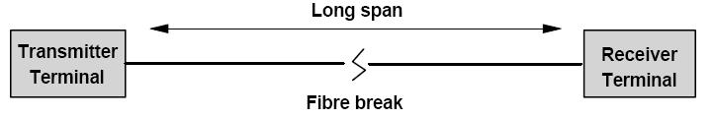
Why we need joints
Fiber can only be installed in lengths upto 2Km, for longer spans a joint is needed.
For the repair of damaged fiber.
For test purpose at terminal equipment.

Slide 4
All of the fiber cable in a building cannot be installed as one continues cable run.
joints are needed to complete network cabling.
Temporary access is needed for test purposes.

Slide 5
Fiber Pigtail
Fiber optic transmitter and receivers are terminated to a fiber optic Pigtail.
A fiber pigtail is a short length of optical fiber (usually 1 meter or less) permanently fixed to the optical source or detector.
Manufacturers supply transmitters and receivers with pigtails and connectors
Reduced coupling loss results when source-to-fiber and fiber-to-detector coupling is done in a controlled manufacturing environment

Slide 6

Fiber joint loss
In fiber-fiber connection the optical loss encountered at interface.
The loss in optical power through a connection is defined as
Po is the power emitted from the source fiber
Pi is the power accepted by the connected fiber

Slide 7
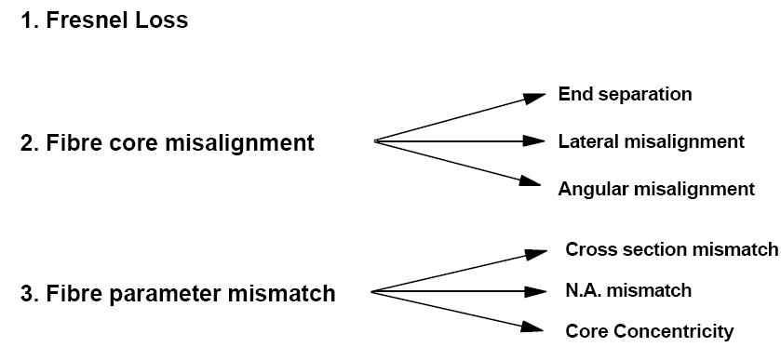
Fiber joint loss (cont…)
Fiber-to-fiber connection loss is affected by intrinsic and extrinsic coupling losses.
Intrinsic coupling losses are caused by inherent fiber characteristics.
Extrinsic coupling losses are caused by jointing techniques.
sources of loss in Fiber-to-fiber joint

Slide 8
Fiber joint loss (cont…)
Intrinsic coupling losses are limited by reducing fiber mismatches between the connected fibers.
This is done by procuring only fibers that meet stringent geometrical and optical specifications
Extrinsic coupling losses are limited by proper connection procedures.

Slide 9
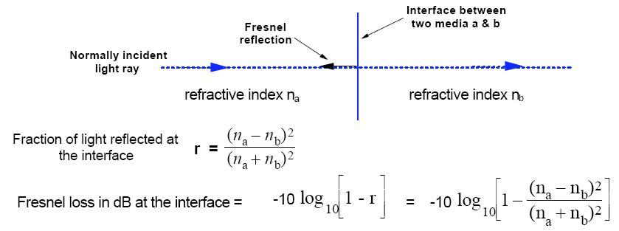
Fresnel Loss (Return Loss)
When optical fibers are connected, optical power may be reflected back into the source fiber.
Light that is reflected back into the source fiber is lost.
This reflection loss, called Fresnel reflection, occurs at every fiber interface.
Fresnel reflection is caused by a step change in the refractive index that occurs at the fiber joint.

Slide 10
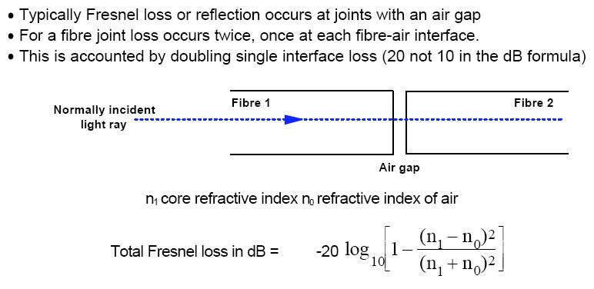
Fresnel Loss

Slide 11
Reducing Fresnel Loss
To reduce the amount of loss from Fresnel reflection, the air gap can be filled with an index matching gel.
The refractive index of the index matching gel should match the refractive index of the fiber core.
Index matching gel reduces the step change in the refractive index at the fiber interface.

Slide 12
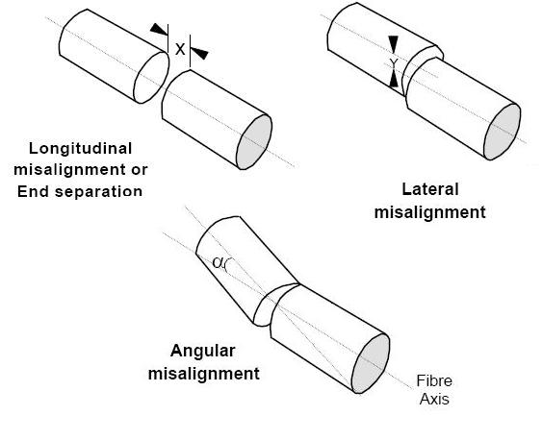
Misalignment losses
These losses depends upon the fiber type , core diameter and the distribution of the optical power.

Slide 13
End separation Loss

Slide 15
Fiber Splice
A permanent joint formed between two individual optical fibers in the field or factory is known as a FIBER SPLICE.
Used to establish long haul optical fiber links
Two types of splicing:
1. Fusion splicing
2. Mechanical splicing

Slide 16
Prior to splicing both fibers must be prepared:
Remove plastic buffer coatings on both fibres
Cleave fibre end and clean with isopropyl alcohol
Good fibre end preparation is vital if a low loss splice
is to be achieved.

Slide 17
Fusion Splice
Melts the fibers together to form a continuous fiber
The source of heat is usually an electric arc, but can also be a laser, or a gas flame, or a tungsten filament through which current is passed.

Slide 18
Fusion Splice Principles
Cleaved fiber ends are fused permanently together using an electric arc
During splicing fibers area held in V-grooves for alignment
A variety of splices have developed to cater for multimode and singlemode fiber

Slide 19
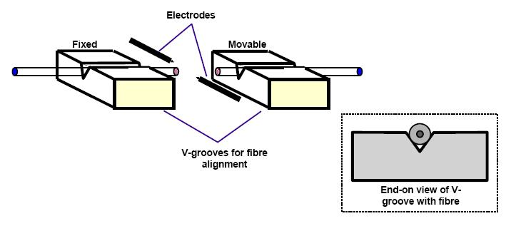

Slide 20
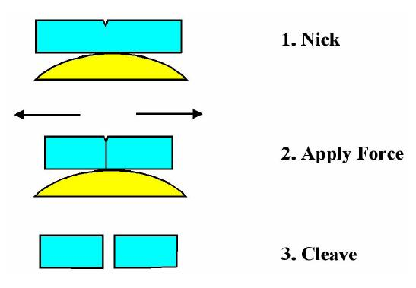
Cleaving Steps

Slide 21
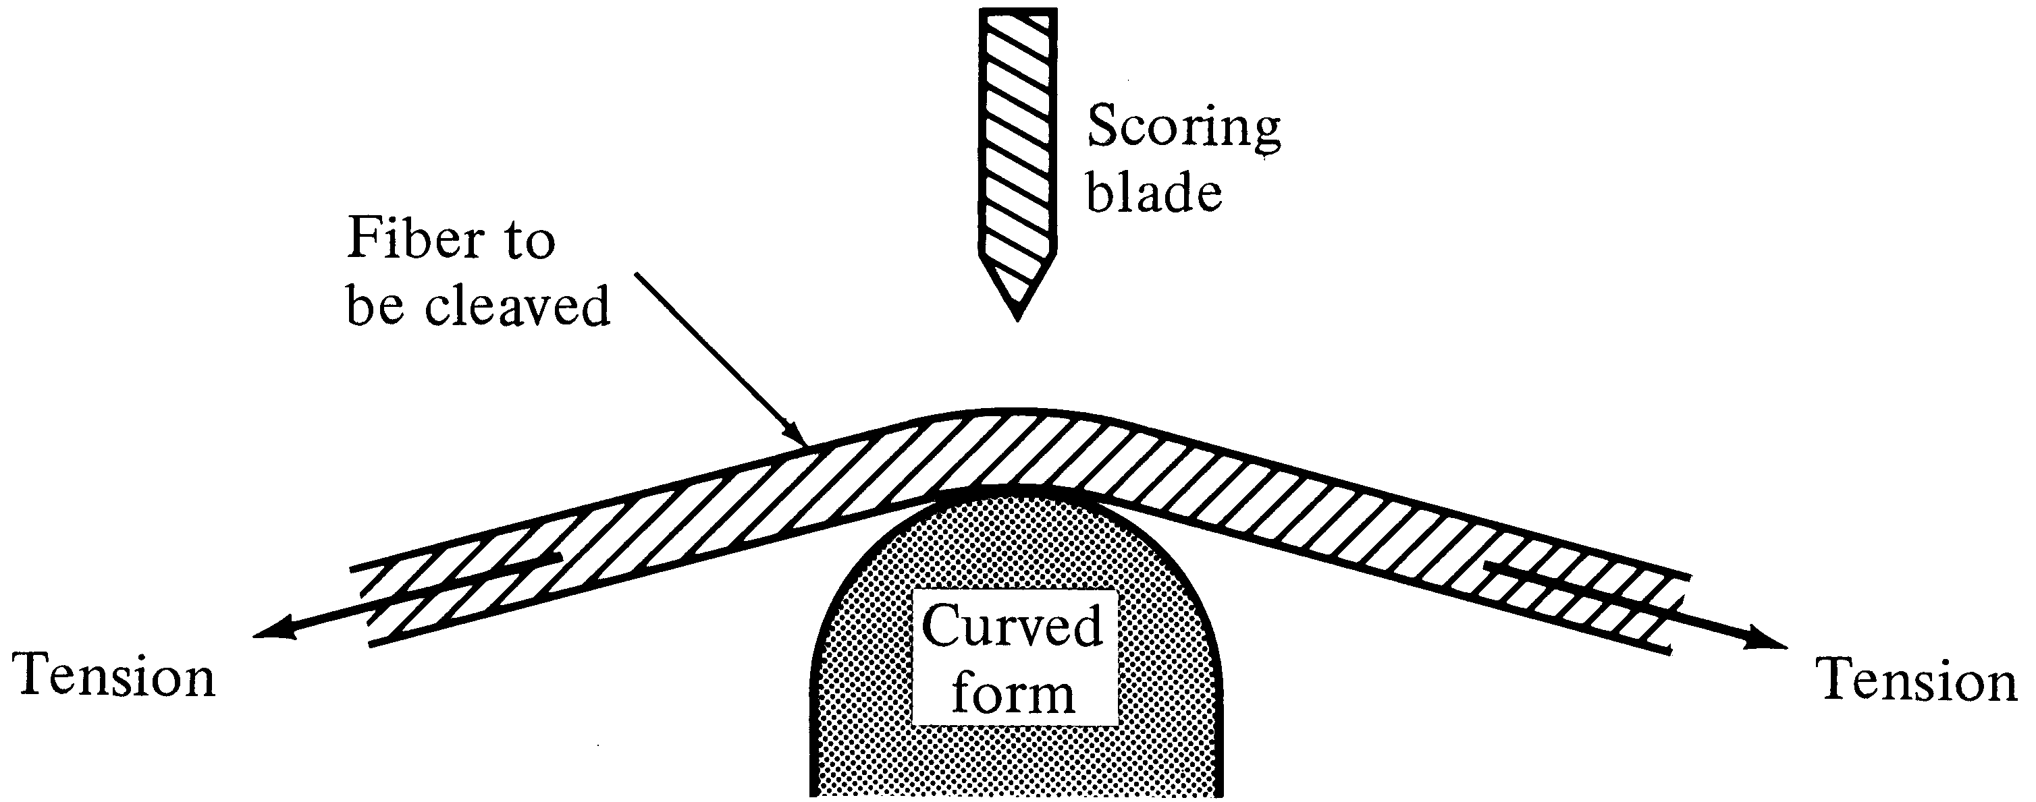
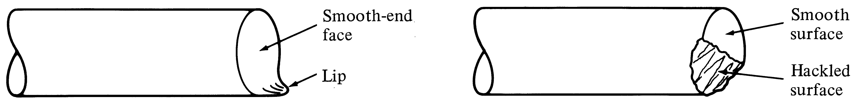
Fiber End Face

Slide 22
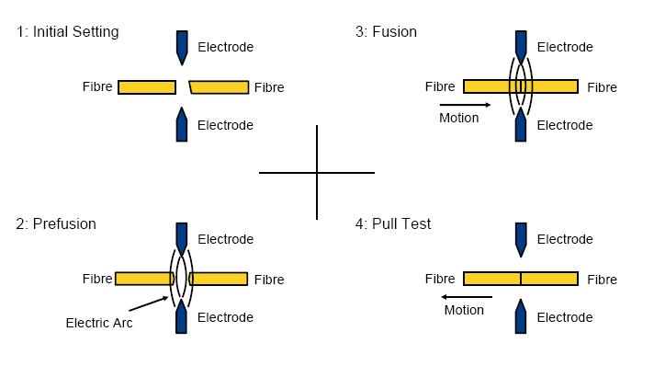
Steps in Fusion Splice Process

Slide 23
Fusion Splice loss

Slide 24
Which Splice?
If cost is the issue, we've given you the clues to make a choice: fusion is expensive equipment and cheap splices, while mechanical is cheap equipment and expensive splices. So if you make a lot of splices (like thousands in an big telco or CATV network) use fusion splices. If you need just a few, use mechanical splices. Fusion splices give very low back reflections and are preferred for singlemode high speed digital or CATV networks. However, they don't work too well on multimode splices, so mechanical splices are preferred for MM, unless it is an underwater or aerial application, where the greater reliability of the fusion splice is preferred.

